Slide 1



Crowd Manager Training Program
Louisville Fire Department
Fire Prevention Bureau

Slide 2


Introduction
Completion of this training program will provide the basic knowledge required by the locally adopted fire code for Crowd Managers.

Slide 3
Objectives
Background on why Crowd Managers are important and now required
Define public assembly and Crowd Manager
Understand the requirements of a Crowd Manager
Understand the roles and responsibilities of a Crowd Manager
Crowd Management techniques
Fire & Life Safety equipment
Evacuation
Interior finishes
Emergency Reporting procedures
Understand human and crowd responses to emergencies

Slide 4
Background
Some of the deadliest fires in US history have involved places of assembly.
Case studies
What are the common themes of these tragedies?

Slide 5
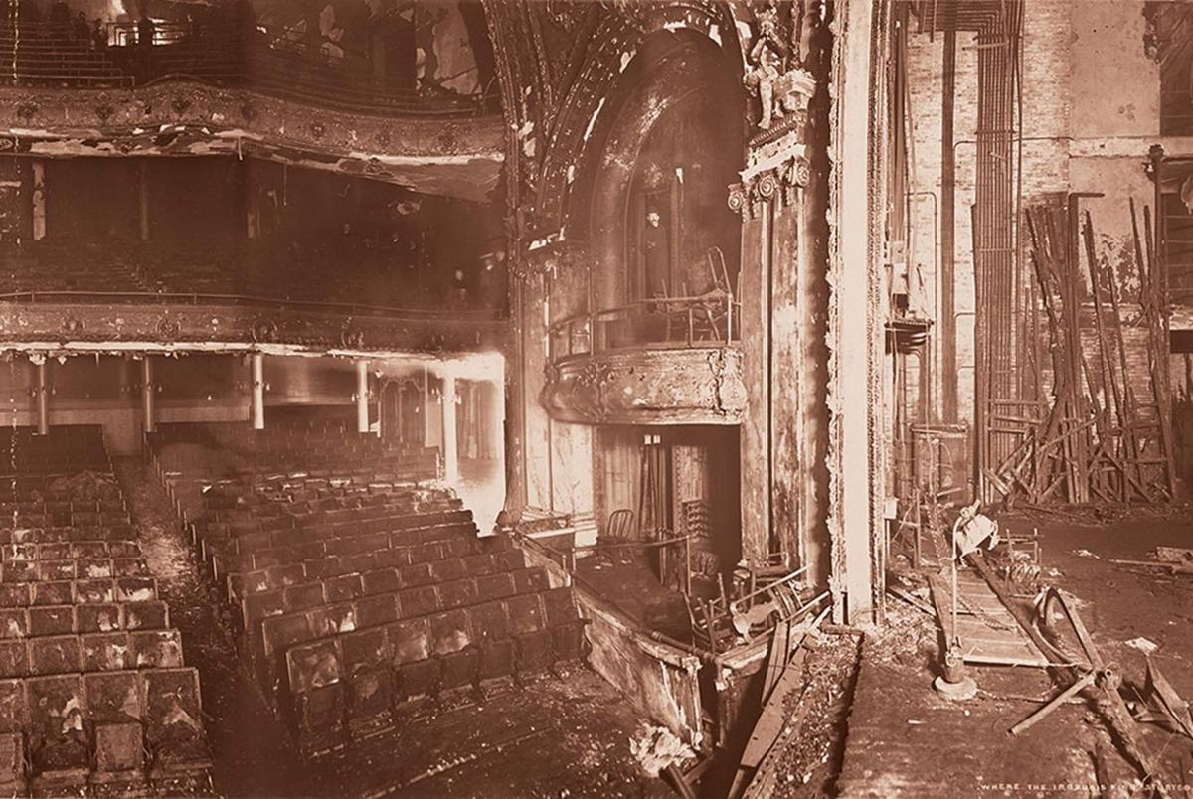
Iroquois Theater
Chicago, IL 1903
Deaths - 602
Cause: arc light ignited stage curtains
Asbestos fire curtain failed, allowing toxic smoke into auditorium.
Fire exits were hidden by draperies and secured with unfamiliar locks
Mass panic, bodies were found stacked 10 feet high around blocked exits

Slide 6
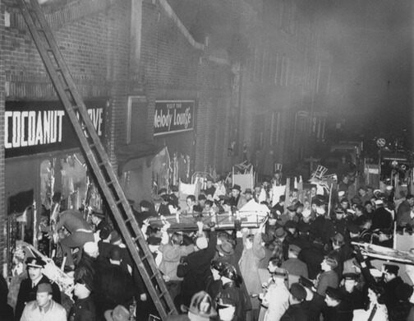
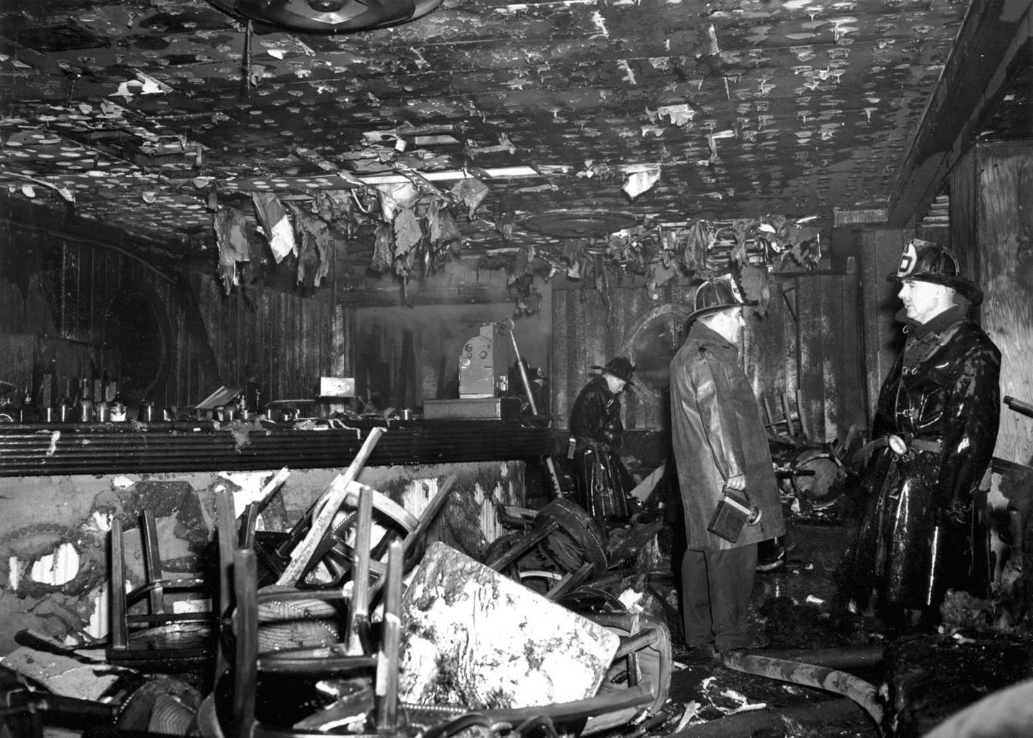
Cocoanut Grove Nightclub
Boston, MA 1942
Deaths – 492
Cause: believed to be match that ignited flammable wall and ceiling material
Building was grossly overcrowded
Inadequate fire protection systems
Inadequate exits
Poorly trained staff

Slide 7
Rhythm Club Dance Hall
Natchez, MS 1940
Deaths 209
Discarded match or cigarette ignited highly flammable decorations
21 of 24 windows were boarded shut
Rear exit was padlocked and boarded shut
Doors at front exit swung inward

Slide 8
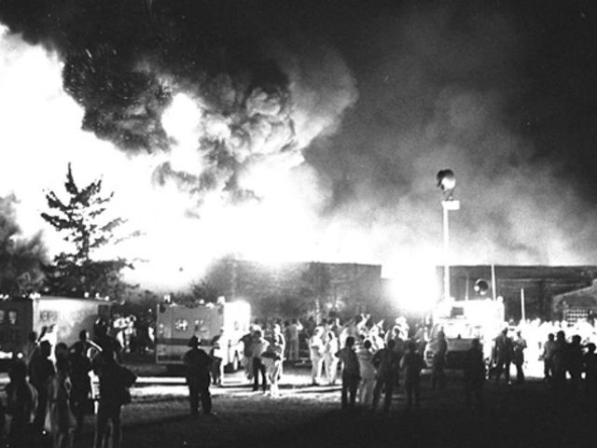
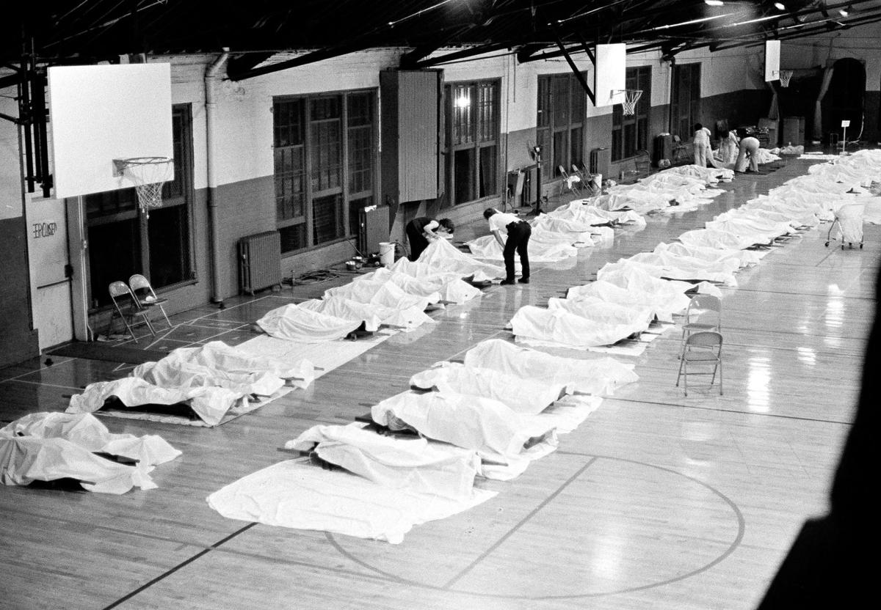
Beverly Hills Supper Club
Southgate, KY 1977
Deaths - 165
Cause: believed to be electrical malfunction
Overcrowded
Inadequate fire exits
Faulty wiring
Poor construction
No fire protection systems
Lack of inspections and oversight

Slide 9
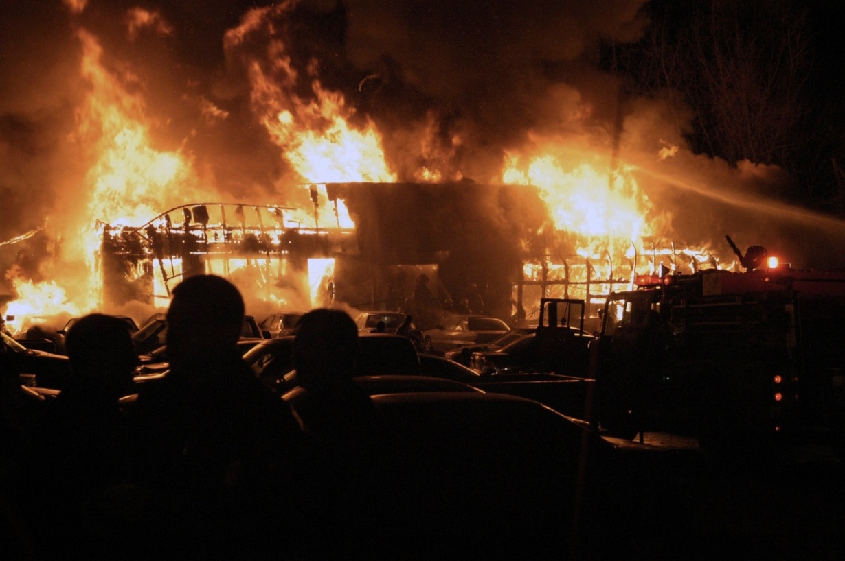
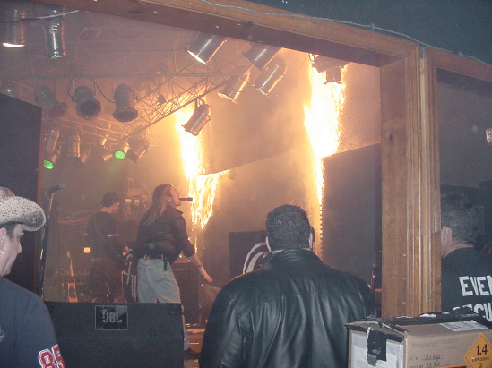
The Station Nightclub
West Warwick, RI 2003
Deaths - 100
Cause: Unapproved indoor pyrotechnics ignited flammable wall and ceiling material
Gross overcrowding
Inadequate fire protection systems
Inadequate exits
Poorly trained staff

Slide 10
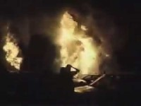
The Station Nightclub – Video
A local news cameraman happened to be in attendance to film a piece on nightclub safety and coincidentally recorded one of the deadliest fires in modern history, from beginning to end
*WARNING – GRAPHIC IMAGERY*

Slide 11
Other tragic assembly fires
Conway’s Theater – Brooklyn, NY 1876 Deaths – 492
  Fire originated on side of stage
  Water buckets and standpipe with fire hose were not readily available
  Personnel attempted to snuff the fire, allowing the performance to continue and delaying evacuation
  Panic eventually took over, resulting in chaotic and untimely evacuation
Rhoads Opera House – Boyertown, PA 1908 Deaths –170
  Kerosene lamp knocked over and started fire
  Stage and auditorium located on 2nd floor
  Few emergency exits were unmarked or blocked
  Two fire escapes were only accessible from windows located too high off floor
  Panic ensured and many of the victims were crushed in narrow main entrance stairway
Ringling Brothers and Barnum & Bailey Circus – Hartford, CT 1944 Deaths 167
  Small fire began in main tent
  Power failed and orderly evacuation announcement could not be heard
  Flammable waterproofing wax on tent caused fire to spread rapidly
  At least 2 exits were blocked by animal chutes
  Most of the victims died during the hysteria, many going back into the tent to find family members
  Fiery tent collapsed and melted in about 8 minutes

Slide 12
Non-fire assembly tragedies
Italian Hall – Calumet, MI 1913 Deaths 73
  Inadequate exits
  Some falsely yelled “Fire” at a mining company Christmas party causing a stampede when the crowd panicked
  Of the 73 deaths, 59 were children
  Responsible for the “shouting FIRE in a crowded theater” to create panic analogy
E2 Nightclub – Chicago, IL 2003 Deaths 21
  Triggered by security guard using pepper spray to break up a fight
  Stampede ensued and victims were crushed trying to exit a lone steep stairwell with doors that opened inward

Slide 13
Non-fire assembly tragedies
The Who concert – Cincinnati, OH 1979 Deaths – 11
  Unmanaged crowd had gathered to enter
  Band was late going on, causing agitated crowd outside
  Band began soundcheck inside, which was heard outside, causing the crowd to believe the concert had started
  Resulted in a crush of people trying to enter the coliseum
City College – New York, NY 1991 Deaths – 9
  Hip-hop celebrity basketball game in a small gym that was heavily promoted
  Huge crowd of people rushed the building and erroneously chose doors that lead into a stairwell, not the gym, crushing 9 victims

Slide 14
Common Themes
Flammable wall and ceiling materials
Inadequate/hidden/blocked exits
Gross overcrowding
Lack of crowd management
Inadequate fire protection systems
Poorly trained staff
Other issues:
  Unfamiliar door lock devices
  Shoddy construction
  Lack of inspections, oversight, maintenance

Slide 15
Positive Outcomes
Three days prior to the Station Night Club fire, a fire broke out in a Minneapolis club
  Also started by band setting off pyrotechnics
  However, automatic sprinklers controlled the fire and an immediate and orchestrated evacuation of 120 patrons was made
  Zero injuries or deaths

Slide 16
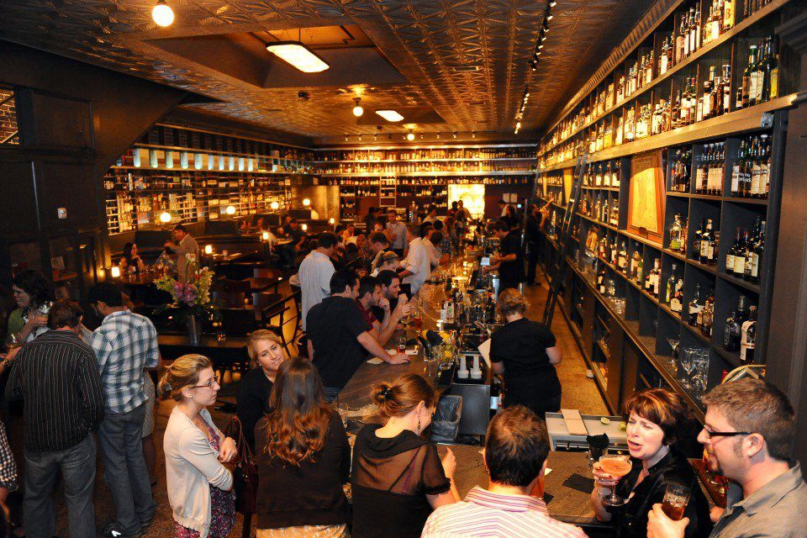
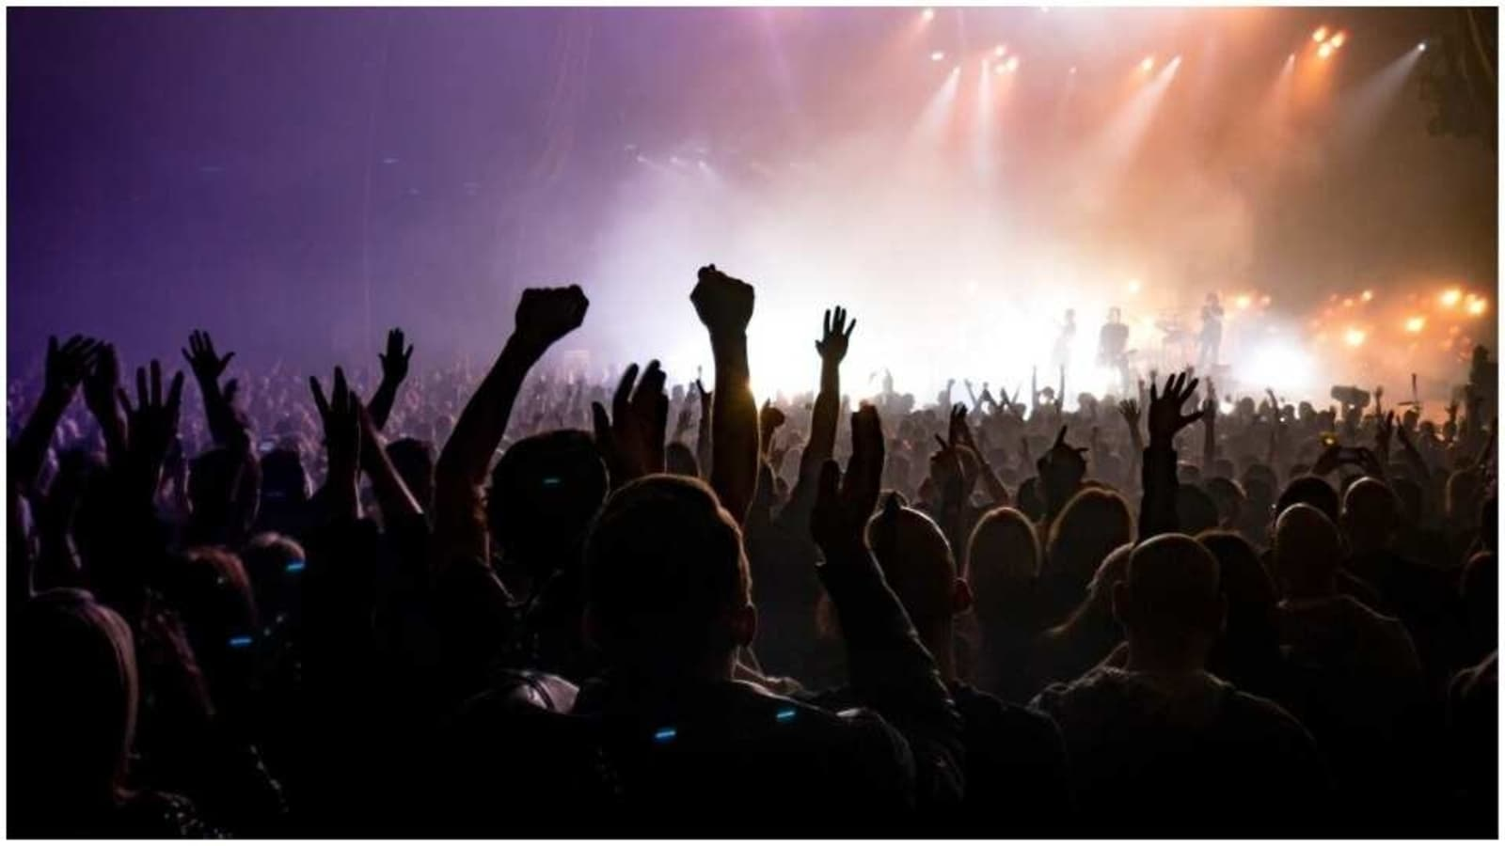
What is a public assembly occupancy?
Any location where 50 or more people gather.
Examples of public assemblies:
  Arenas, bars, concert venues, hotels, nightclubs, restaurants, etc.

Slide 17
Code Requirements
NFPA 101 – Life Safety Code, 2018 edition
  Assembly occupancies shall be provided with a minimum of one trained Crowd Manager or crowd manager supervisor. Where an occupant load exceeds 250, additional trained crowd managers/supervisors shall be provided at a ratio of 1 crowd manager for every 250 occupants, unless otherwise permitted by the Fire Marshal.
NFPA = National Fire Protection Association

Slide 18
Code Requirements
50-250 persons: 1 Crowd Manager
251-500 persons: 2 Crowd Managers
Every additional 250 persons, add 1 Crowd Manager

Slide 19
Code Requirements
The E S C A P E acronym can be used as a reminder for some of the common code requirements and considerations for Public Assembly occupancies:
  Exits (clearly marked, illuminated, unlocked, and unobstructed)
  Storage (orderly and not excessive)
  Capacity (never exceed posted occupancy)
  Aisles (free and clear at all times)
  Protection (fire alarm, sprinkler systems, etc in proper working order)
  Emergency Lighting (in proper working order)

Slide 20

Exits
Are all exits clearly marked and illuminated?

Slide 21
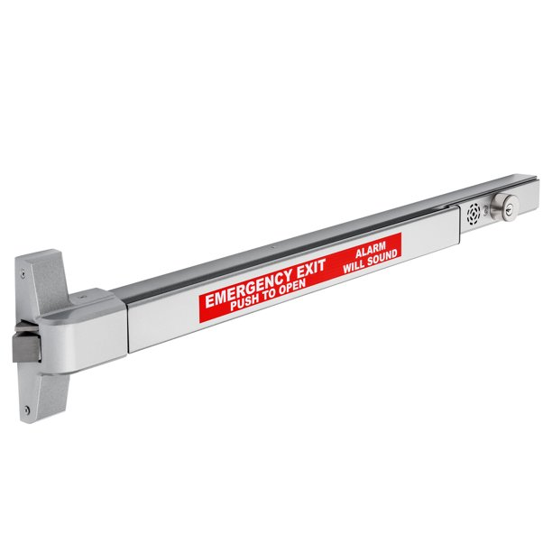
Exits
Is required panic hardware present on exit doors functioning properly?

Slide 22
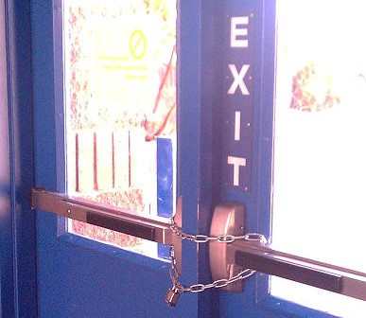
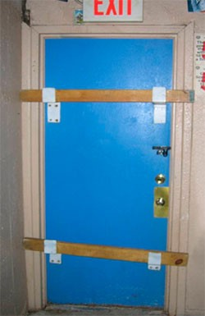
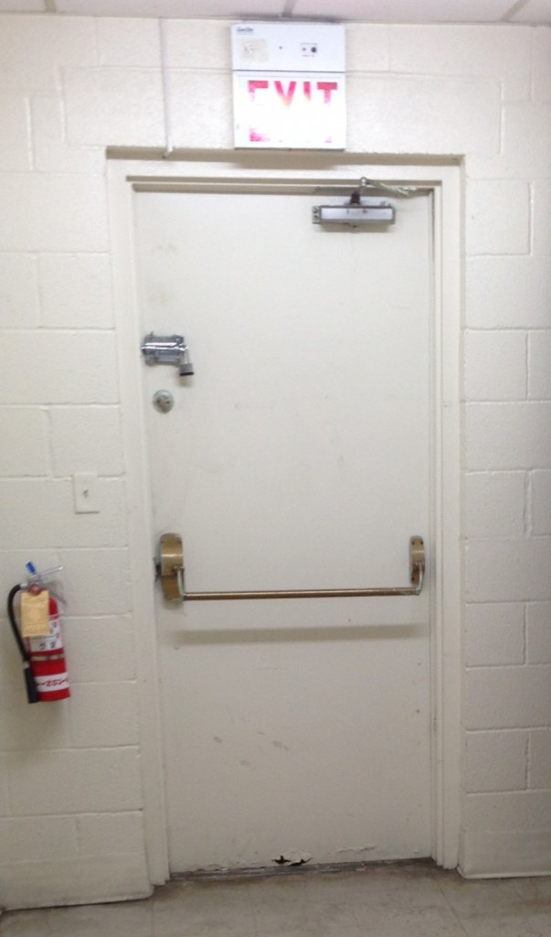
Exits
Are all exits unlocked?
  Exit doors cannot be chained at any time
  Exit doors cannot be barricaded at any time
  Additional locking devices cannot be added to doors equipped with panic hardware

Slide 23
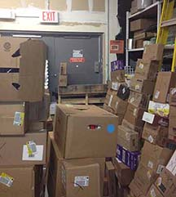
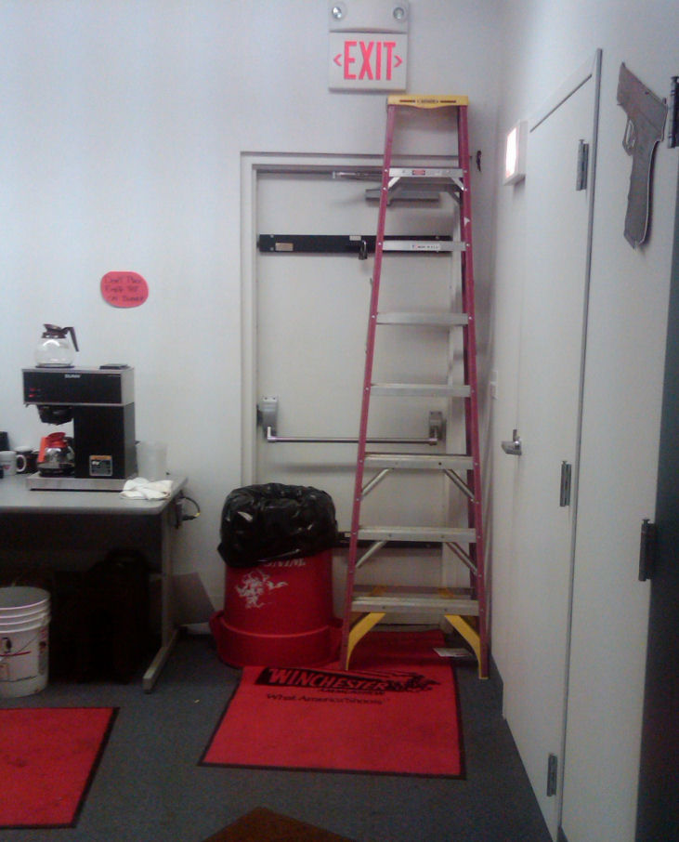
Exits
Are all exits unobstructed?

Slide 24
Exits
During pre-event walk-through, physically open each door:
  Does each door open easily?
  Does the panic bar work properly and not stick?
  Does the door open all the way?
  Are the exits clear and do they open to the public way?

Slide 25
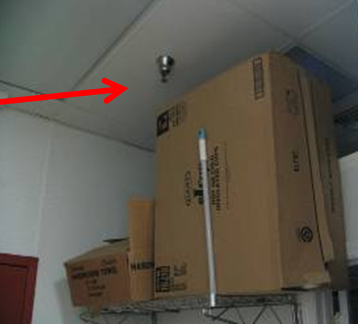
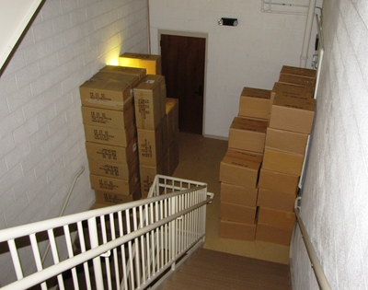
Storage
Is stock or storage blocking or impeding egress?
Is storage piled too high and impeding fire sprinkler heads?

Slide 26
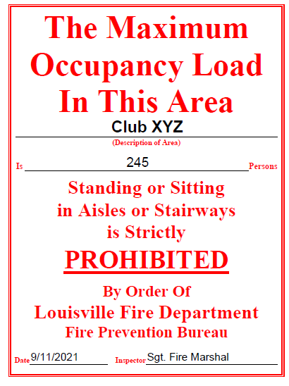
Capacity
A Maximum Occupancy sign provided by the Louisville Fire Department must be clearly posted with the number to be not exceeded.

Slide 27
Aisles
Aisles must be clear and unobstructed
  Must be kept clear during event
  Must be unobstructed
    Free of storage
  Regularly check during event

Slide 28
Protection
Fire alarm and sprinkler system must be in working order.
  Inspected and tested annually.
  Kitchen hood suppression systems inspected every 6 months and vents professionally cleaned regularly.

Slide 29
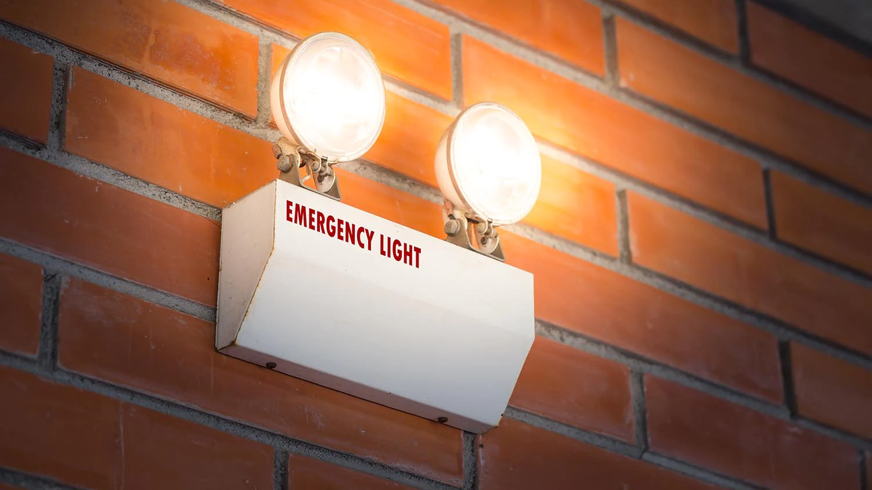
Emergency Lighting
Emergency Lights are required to illuminate spaces in the event of power outages/emergency
Must be tested monthly and annually
  Maintain a log of tests

Slide 30
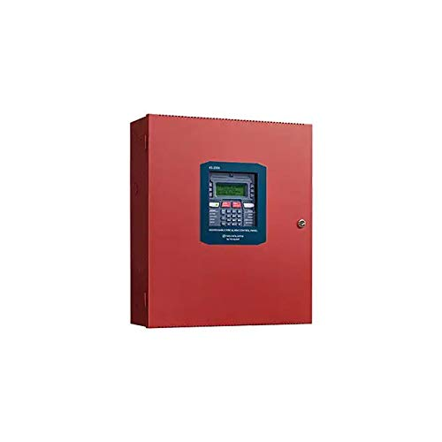
Fire Alarm System
Do you know where the fire alarm panel is located?
Has the fire alarm system received its annual inspection?
Does the panel show power and normal operation?
Does the panel show a "trouble" signal?
If not operating properly, call a technician.

Slide 31
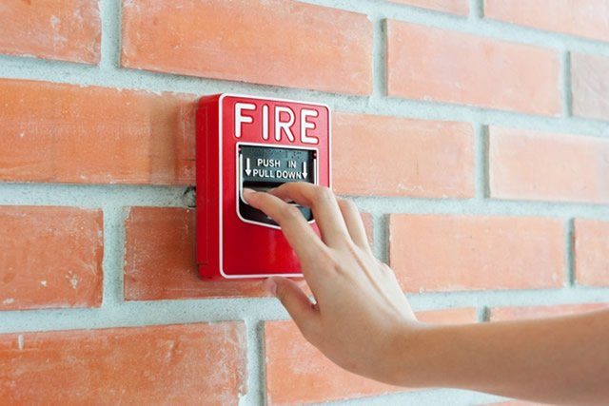
Fire Alarm System
Know where fire alarm pull stations are located. Are they visible and unobstructed?

Slide 32
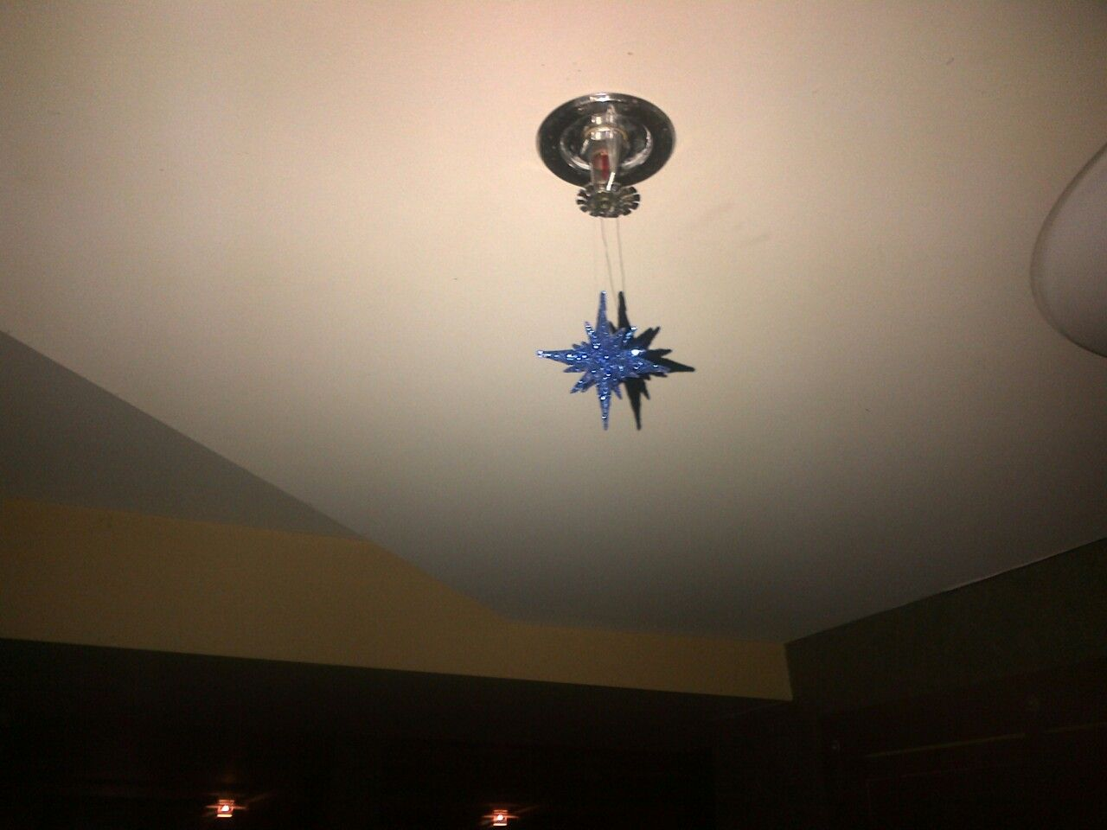
Fire Sprinkler System
Are you familiar with sprinkler heads and how they operate?
Sprinkler heads must be maintained as installed.
  Cannot be painted over
  Cannot hang decorations from sprinkler heads and piping

Slide 33
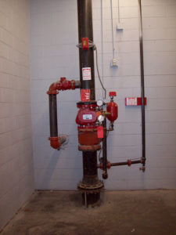
Fire Sprinkler System
Do you know where the sprinkler valves (riser) are?
Is the sprinkler system in working order?
Has it received an annual inspection?
Is the riser unobstructed?

Slide 34
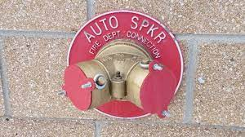
Fire Sprinkler System
Fire Department Connection (FDC) on exterior of the building must be unobstructed and secure (protective caps in place)

Slide 35
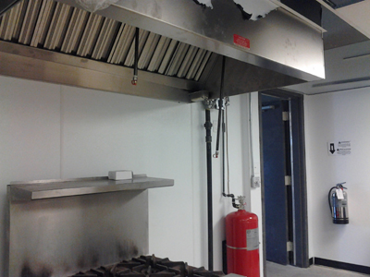
Kitchen Hood Suppression System
Many assemblies have kitchens and cooking equipment that are required to be protected by commercial hood, ventilation, and suppression equipment
  Hood and ventilation must be professionally cleaned regularly
  Suppression system must be inspected semi-annually

Slide 36
Special Amusement Occupancies
Haunted Houses
  Haunted Castle Six Flags NJ 1984 – 8 teens trapped and killed in fire
  Requirements today:
    Smoke detection and fire alarm system
    Fire sprinkler system
    Emergency voice communication system
      Interface to immediately turn off music/effects and turn on lights upon alarm activation
    Exit lighting and lighted path to exit
    Approved directional exit markings where mazes and such are utilized to confuse direction
    Class A (noncombustible) interior finishes

Slide 37
Crowd Manager Responsibilities
Provide a safe environment for all occupants.
Correct fire code violations.
Preventative measures, regular maintenance, and routine housekeeping lead to a safer assembly space.

Slide 38
Emergency Action Planning
Your business must also develop written emergency plans including:
  Crowd Management Plan
  Emergency Evacuation Plan
  Employee Fire Safety Training & Response
  Emergency Evacuation Drills

Slide 39
Crowd Management Plan
Event type, know your audience
Know facility layout
  Patrons will often attempt to exit where they entered. It is important for Crowd Managers to know each exit and be able to direct patrons to the NEAREST exit
Expected crowd
Risk assessment
Adequate signage and markings
Parking, entry, exits
Ticketing, restrooms, concessions

Slide 40
Emergency Evacuation Plan
Specific evacuation procedures for each area of the venue, including Emergency egress routes.
Staff/patron accounting
Locations of designated assembly points.
Procedures for reporting an incident.
Staff responsibilities.
A note regarding fire alarm activations:
  Do not reset fire alarm during an event even if it is believed it is false. Let the fire department check before resetting the system.

Slide 41
Employee Fire Safety Training & Response
Know individual responsibilities and limitations
New employee orientation and regular training
Record keeping
  Fire alarm inspection reports, sprinkler inspection reports, kitchen hood inspection reports, monthly fire extinguisher inspection log, emergency light inspection log, etc.

Slide 42
Employee Fire Safety Training & Response
Train staff on the use of portable fire extinguishers.
The Louisville Fire Department provides fire extinguisher training for groups on request, free of charge.

Slide 43
Emergency/Evacuation Drills
Conduct drills at least quarterly
  At unexpected times under varying conditions, to avoid complacency
Record keeping
  Document fire extinguisher training and drills - dates, methods, personnel on duty, etc.

Slide 44
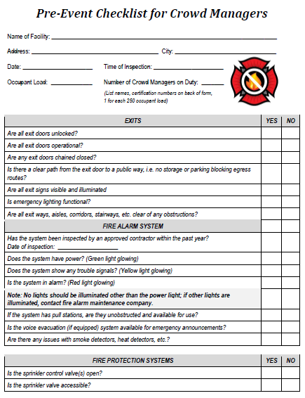
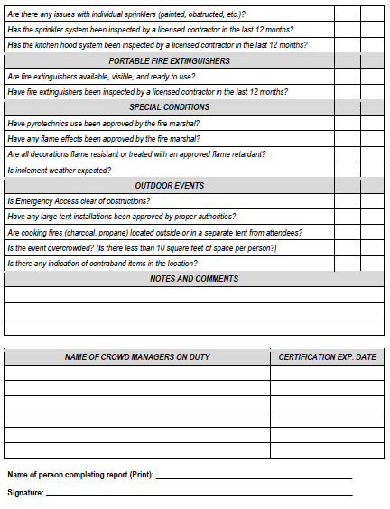
Complete a Pre-event checklist before event / Opening for the day

Slide 45
Pre-event Checklist: Exits
Are all exit doors unlocked?
Are all exit doors operational?
Are any exit doors chained shut?
Exit doors swing outwards
Is there a clear path from exits to public ways? No exits blocked on outside?
Are all exit lights illuminated?
Is emergency lighting operational?
Are all exits, aisles, corridors, stairways clear and unobstructed?
Is Capacity posted, visible, and known to employees?

Slide 46
Pre-event Checklist: Sprinklers
Has sprinkler system been inspected in last 12 months?
Are the valves at the riser open?
Are there decorations hanging from sprinkler heads or piping?
Has kitchen hood suppression system been inspected in last 6 months?

Slide 47
Pre-event Checklist: Fire Alarm
Has fire alarm system been inspected in last 12 months?
  Does panel show power? Is there a trouble signal? Is it alarm mode?
  Are fire alarm pull stations unobstructed and in working order?
Is voice activation system in working order?
  Will the lights turn on and music turn off in event of emergency?

Slide 48
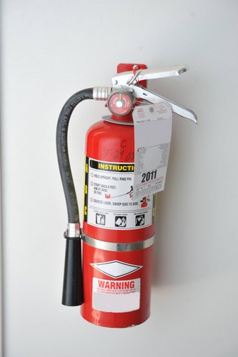
Pre-event Checklist: Fire Extinguishers
Are fire extinguishers available, visible, and read for use?
  Have they been checked monthly and inspected in last 12 months?

Slide 49
Pre-event Checklist: Special Conditions
Are interior finishes, such as stage curtains and wall fabrics, flame retardant?
  Is documentation on hand?
Pyrotechnics and flame effects are strictly prohibited unless approved and permitted by Louisville Metro and the Louisville Fire Department
Is inclement weather expected?
  Do you have a severe weather plan?

Slide 50
Pre-event Checklist: Outdoor Event
Is emergency access/egress of outdoor even clear from obstructions?
Have tents over 400 square feet been approved and permitted by Louisville Metro?
Is the outdoor event overcrowded?

Slide 51
During the event
Walk the rooms and make sure exit paths are staying clear
Educate employees on the importance of keeping exit paths clear
Look for situations that could challenge evacuation and egress
Fixed seating must remain fixed
Maintain posted capacity

Slide 52
Occupant Load
Monitor your occupant load:
  Track the number of persons entering and exiting the building.
  Never exceed your posted occupancy number
  Your occupancy has been set by professionals, based on factors such as square footage, number and width of exits, and use of the space

Slide 53
Occupant Load
If you have inadvertently exceeded your occupant load:
  Stop entry of new patrons
  Ask those nearest the entrance to step back outside, then work inward
  Take a head count if necessary
  Once capacity is met, patrons can be allowed back in, as others leave, 1 for 1

Slide 54
Occupant Load
If occupant load is still in excess:
  Stop serving alcohol
  Close the facility
  Shut down the music/entertainment
  Make an announcement that people need to leave the premises
  Clarify there is no emergency and ask patrons to calmly exit
  Contact police/fire department/Fire Marshal, if you need assistance

Slide 55
In the event of an emergency
Make an announcement to evacuate
  Calmly direct patrons to nearest exit
  Do not reserve “special” exits, such as “Band Only”
  Use all exits
  Ensure communication between exit points if necessary to safely direct the flow of egress traffic, minimizing congestion

Slide 56
Portable Fire Extinguisher Use
Sound the fire alarm – activate pull station and call 911
Evacuate if necessary
If you choose to extinguish a small fire, choose an emergency evacuation path
If the fire is too large and you do not know how to use an extinguisher or are uncomfortable, evacuate

Slide 57
Portable Fire Extinguisher Use
Choose appropriate fire extinguisher
  Multi-purpose Class ABC extinguisher
    Most fires
  Class A water extinguisher
    Ordinary combustibles only
  Class BC carbon dioxide extinguisher
    Flammable liquids, energized electrical fires
  Class K kitchen extinguisher
    Kitchen/grease fires

Slide 58
Portable Fire Extinguisher Use
PASS method
  Pull pin/seal at handle
  Aim at base of fire (6 to 8 feet away)
  Squeeze handles together
  Sweep nozzle side to side
If fire progresses or smoke is too toxic, evacuate immediately

Slide 59
Closing
Thank you for taking the Louisville Fire Department’s Crowd Manager Training Program
Please click on the following link to take a short exam. Upon passing, a record will be kept by Louisville fire confirming your completion and passing of the course.
EXAM LINK
#FIRESAFE502

